Slide 1

ECE 696B: Spring 2025 Trustworthy Machine Learning Lecture 3: Attention & Transformers
Instructor: Dr Ravi Tandon
Department of ECE

Slide 2
Lecture Outline
Paper # 1
First to introduce “attention”
Published in ICLR 2015
”Bahdanau” Attention
Cited 37,451 times
(as of Jan 22, 2025)
Paper # 2
Introduced “Dot-product” Attention
Introduced Transformers
Published in NIPS 2017
Cited 149,860 times
(as of Jan 22, 2025)
Update: Cited 150,084
(as of Jan 23, 2025)

Slide 3
Paper # 1: “Bahdanau et. al”

Slide 4
Recap & Shortcomings of Seq2Seq
Lecture 1: Seq2Seq (Sutskever 2014) proposed an Enc-Dec model
Encoder takes the input/source sequence → converts into a fixed length representation c (denoted as v = hT in Seq2Seq paper)
Decoder: Takes the c and uses it to decode the output sequentially
Output y(t) is generated conditioned on (c, y(1), y(2),…, y(t-1))
Typical RNN/LSTM approach: y(t) = Dec (c, s(t), y(t-1)), where
c = input representation
y(t-1) = previous generated token
s(t) = hidden state
What are some issues/problems with this model ?
Source sequence encoded as a single fixed-length vector c.
Issue 1: Performance degrades as input sequences increase in length.
Issue 2: What if the new sequences (in test set) are longer than those in training ?

Slide 5
New Idea in Bahdanau et. al
Main Idea: Represent source sequence by a sequence of vectors:
Source Represented as: {h(1), h(2),…., h(T)}, where T = length of input sequence.
To generate the ith output token, y(i):
We find the relevant information through an adaptive context vector c(i)
c(i) is a function of all {h(1), h(2), …, h(T)}
c(i) ”attends” to the most important locations in the source sequence
c(i) = a(i,1)h(1) + a(i,2)h(2) + … a(i,T)h(T)
If a(i,j) is large → jth source token is useful/important in predicting ith output (otherwise, a(i,j) is small)
As before, maintain the hidden state s(i)
Decode y(i) = Dec (c(i), s(i), y(i-1))
Key differences from Seq2Seq:
Input influences each output adaptively
Long-range dependence can be included

Slide 6
Decoding Flow.. (Bahdanau et. al)
Output y(i) depends on previous output, current state, current context
State Update
Context Vector
Weights
Alignment Scores
weighted sum of
input “annotations”
(weights given to each
“annotation” for i-th output)
Alignment Score:
i-th output vs j-th input

Slide 7
“Bahdanau et. al. Attention”
Context Vector
Weights
Alignment Scores
weighted sum of
input “annotations”
(weights given to each
“annotation” for i-th output)
Alignment Score:
i-th output vs j-th input

Slide 8
Bidirectional Encoder
Traditional RNNs encode sequence from left to right..and compute ”hidden” states, h(1), h(2), h(3),…h(T) in L→ R order.
This paper proposed Bi-directional RNN (BiRNN)
How does it work ? Take two passes at input. (Quiz: WHY ?)
Take a forward pass, i.e., process the input from left to right
→ obtain h(1), h(2), …, h(T). “forward hidden states”
Take a backward pass, i.e., process the input from right to left
→ obtain h’(T), h’(T-1),…, h’(1). “backward hidden states”
For each input in the source, concatenate the forward/reverse states.

Slide 9
Putting everything together..
Key architectural takeaways
Introduced “attention”
Adaptively using context from input
Bi-directional RNNs for encoding input
Also referred to as “additive attention”
Why ? (see Appendix of the paper; Sec. A)
Attention scores are additive in nature
Linearly combine j-th input’s annotation
Along with (i-1)-output state

Slide 10
Results (1): Improvement in BLEU Scores
Results reported on the WPT 14 dataset (English-to-French translation)
Moses: conventional phrase based translation (considered “high-quality”)
Basic encoder-decoder architectures:
RNNencdec-30 or RNNencdec-50 (30/50 denote the length of training sequences)
Proposed “RNNsearch” attention model:
RNNsearch-30 or RNNsearch-50 (30/50 denote the length of training sequences)

Slide 11
Results (2): Impact of Sentence Length
Key Takeaways
Enc-Dec architecture performance degrades as length increases
“Attention” (RNNsearch-50) does not degrade with length

Slide 12
Results (3): Visualizing “Annotations”/Attention
Key Takeaways
Generally observe alignment across English & French words (monotonic)
Non-monotonic trends as well (off diagonal entries)
E.g.: adjectives & nouns could be ordered differently across languages
For instance [European economic area] → [zone economique europeen]

Slide 13
Paper # 2: “Attention is all you need”

Slide 14
Motivation behind Transformers
All papers until this point used Attention with a Recurrent Architecture
Even though context information from input was used adaptively
Relied on RNN architectures (sequential philosophy)
Proposal of this paper:
Introduced Transformers
Give up on recurrence, entirely rely on attention
Attention should be able to learn global dependencies
Positional Encodings (to account for lack of recurrence)
Significantly more Parallelizable than recurrent architectures

Slide 15
Self-Attention—Key Building Block (1)
Goal: given a sequence of token embeddings (x(1), x(2),…, x(N)), produce a new set of embeddings (x’(1), x’(2),…,x’(N)).
Both input and output embeddings d-dimensional, i.e. x(i) is a 1xd vector.
Self Attention block has three weight matrices:
Query weight matrix: Wq (size = Nxd)
Key weight matrix: Wq (size = Nxd)
Value weight matrix: Wv (size = Nxd)
Step 1: Let us start with the i-th token embedding x(i)
First compute value vector = v(i) = x(i)Wv for the i-th token (d-dimensional)
Think of this as a new ”intermediate” embedding we have obtained from the original embedding x(i).
One can then ”stack” all the N value vectors in a matrix = V (Nxd)
This is called as the Value Matrix = V = X . Wv

Slide 16
Self-Attention—Key Building Block (2)
Self Attention block has three weight matrices:
Query weight matrix: Wq (size = Nxd)
Key weight matrix: Wq (size = Nxd)
Value weight matrix: Wv (size = Nxd)
Step 2: Let us take the i-th token embedding x(i)
Each token now creates a query vector
q(i) = x(i)Wq (d-dimensional)
We can stack all the N query vectors in a Query matrix = Q
Think of “query” as each token’s question..
We now have the Query Matrix = Q = X Wq
Step 3: Let us take the i-th token embedding x(i)
Each token now creates a key vector
k(i) = x(i)Wk (d-dimensional)
We can stack all the N key vectors in a Key matrix = K
Think of “key” as each token’s response..
We now have the Key Matrix = K = X Wk

Slide 17
Self-Attention—Key Building Block (3)
Self Attention block has three weight matrices:
Query weight matrix: Wq (size = Nxd)
Key weight matrix: Wq (size = Nxd)
Value weight matrix: Wv (size = Nxd)
Step 4: Dot-Product Attention:
We would like to see the “similarity” between i-th query and j-th key
How similar is the question raised by the i-th token’s query to the response (key) provided by the j-th token.
Similarity(i, j) = s(i,j) = q(i)^{T} k(j)
s(i,j) represents how much does i-th token “attend” to j-th token.
Stack all the N² pairs of s(i,j) values in a matrix.
We call these as the S matrix (raw-attention scores)
Raw Attention Matrix: S = QK^{T}

Slide 18
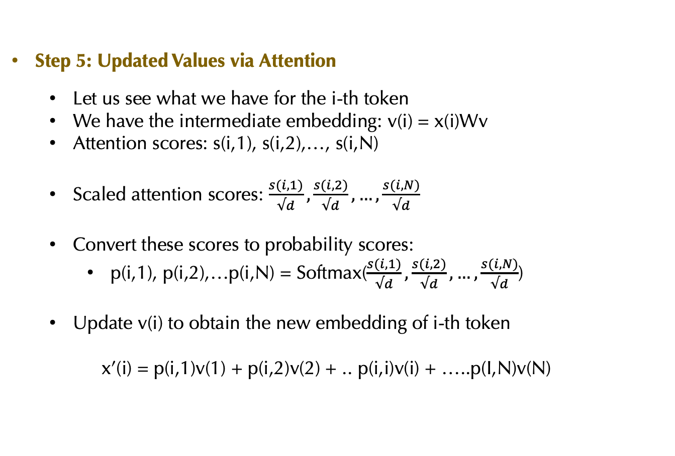
Self-Attention—Key Building Block (1)
Step 5: Updated Values via Attention
Let us see what we have for the i-th token
We have the intermediate embedding: v(i) = x(i)Wv
Attention scores: s(i,1), s(i,2),…, s(i,N)
Scaled attention scores: $\frac{s(i,1)}{√d},\frac{s(i,2)}{√d},…,\frac{s(i,N)}{√d}$
Convert these scores to probability scores:
p(i,1), p(i,2),…p(i,N) = Softmax($\frac{s(i,1)}{√d},\frac{s(i,2)}{√d},…,\frac{s(i,N)}{√d}$)
Update v(i) to obtain the new embedding of i-th token
x’(i) = p(i,1)v(1) + p(i,2)v(2) + .. p(i,i)v(i) + …..p(I,N)v(N)

Slide 19
Scaled Dot-Product Attention (Summary)

Slide 20
Multi-head Attention
Rinse & Repeat attention block multiple independent times
h times/ h attention “heads”
Each head has it’s own triple of key, query and value weight matrices.
Concatenate the outputs of heads→ Combine them back to size d
Final embeddings after multi-head attention block.

Slide 21
Positional Encoding
Since we gave up on recurrence, we need to encode positions of the tokens in the sequence.
Idea: Positional Encodings. For each token i, create a positional encoding (of dimension d).
Final input: add token embeddings with Positional encodings

Slide 22
Final Transformer Architecture

Slide 23
Results (1): State-of-the-art in MT

Slide 24
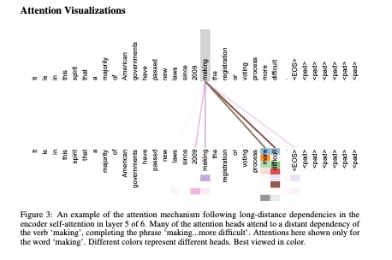
Results (2): Visualizing Attention

Slide 25
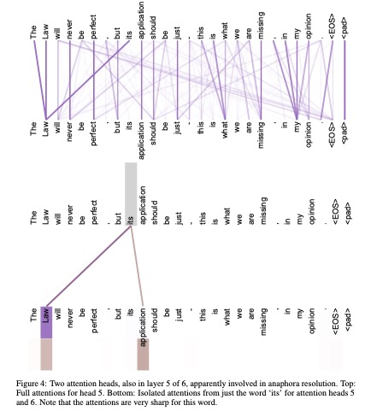
Results (3): Role of Multiple Attention Heads

